Slide 1
Predicting Traffic Violations
GA Data Science Final Project - November 2016
By Lucas Hedinger

Slide 2
Background
Trivia
Every year, approx. 30,000 people die in traffic accidents in the nation
On average, 100,000 people get pulled over daily across the country
250 million vehicles on the road each year
D.C. and Maryland Drivers Are the Worst

Slide 3
Hypothesis
Can we predict rate of traffic violations and their severity based on historic data?
Can we predict the odds by the type of car someone drives?
What about day of week or hour of day?
Is the color of the car a significant factor?

Slide 4
The Data
What we are working with

Slide 5
Sources
Data.gov – traffic violations
List of all recorded traffic violations from 2015
Edmunds.com – sales by make
Indicator of how popular a car make is on the road

Slide 6
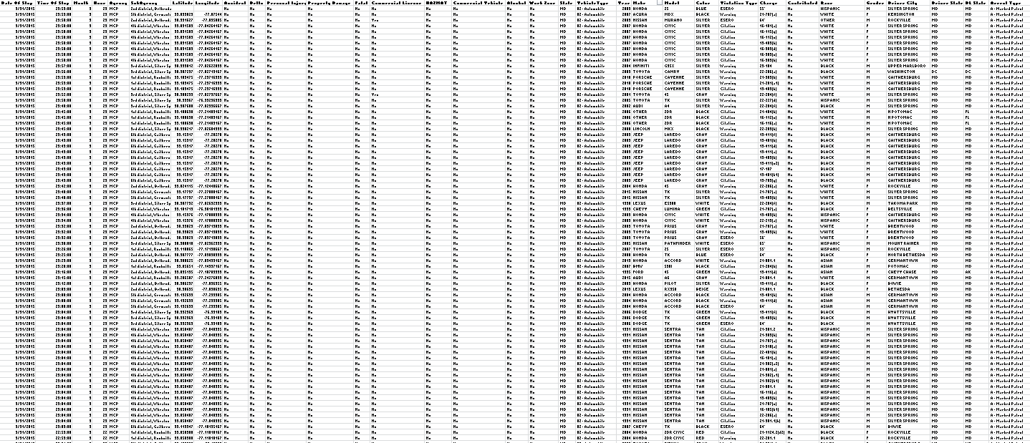
Traffic Violation Data
CSV with ~1 million rows of raw data
Date-time of violation
Geolocation
Make, Model, Year and Color of Car
Yes/No flags to indicate if violation had fatalities and/or property damage
Description of violation and police department

Slide 7
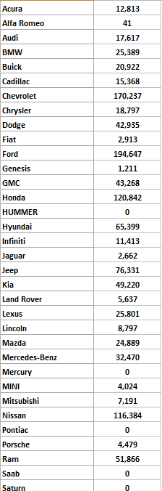
Edmund Sales Data
Amount of sales by year and make
Break-down of marketshare percentage
Allows us to weigh the data when we analyze it by make

Slide 8
Pre-Processing
The Data

Slide 9

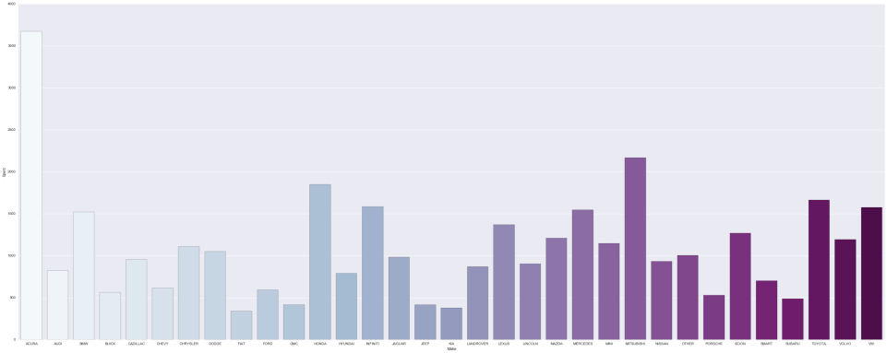
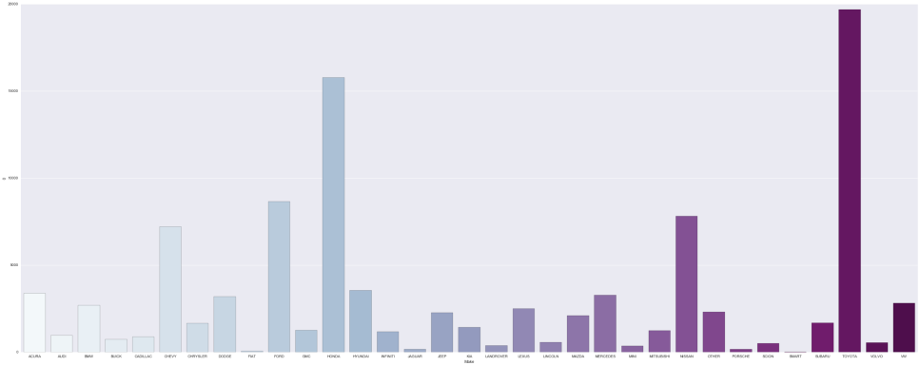
+ =
Normalizing the make frequency
Scaling the make counts of each make with their percentage
Honda
Toyota
Honda
Toyota

Slide 10
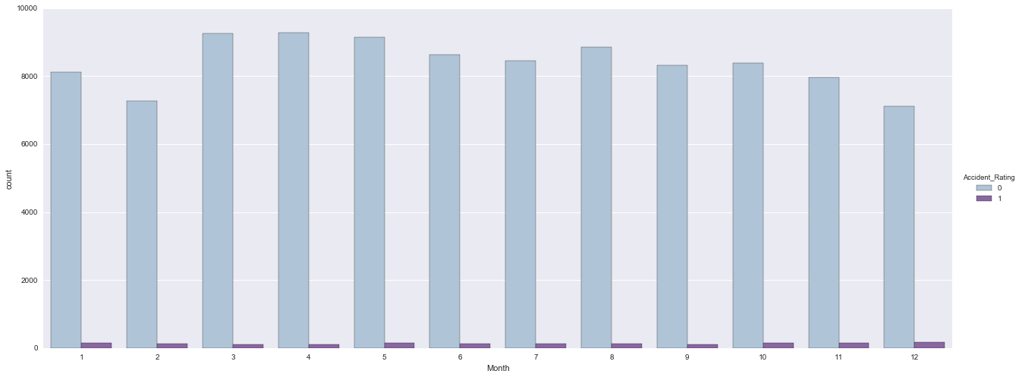
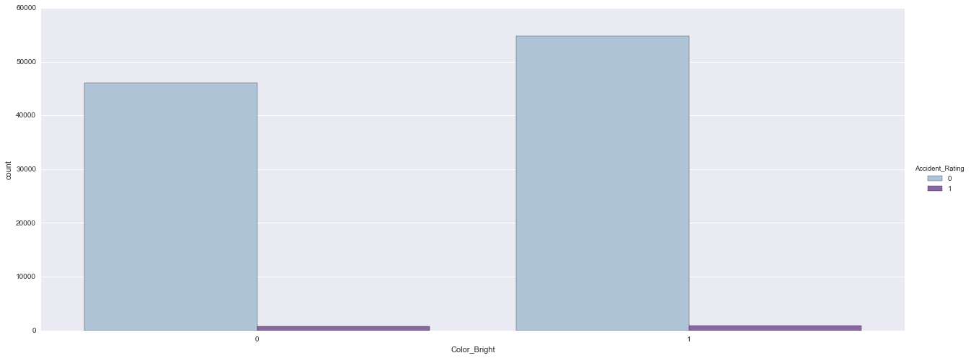
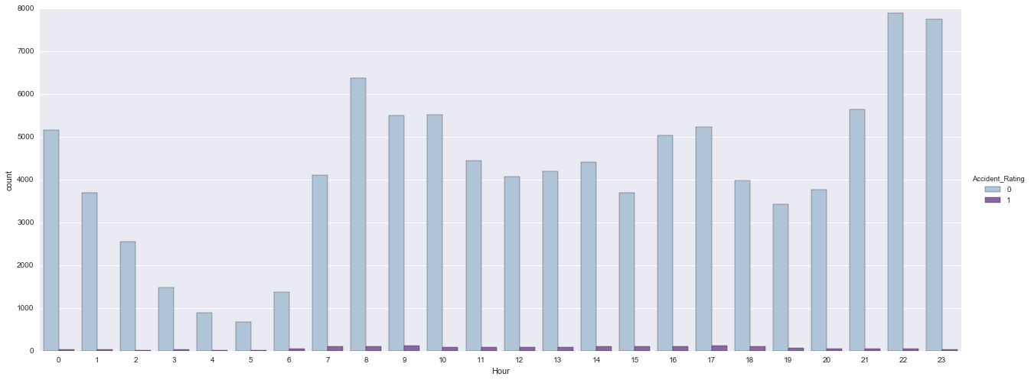
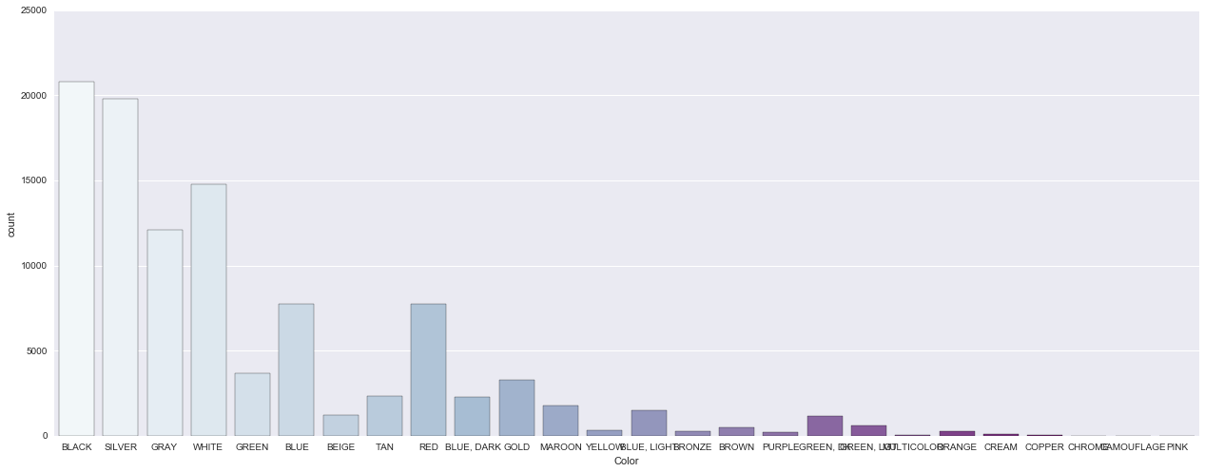
Visualizing the Data
Categorical Counts on Color, Make, etc.
Frequency by Date-Time
Grouping by Accident Rating

Slide 11
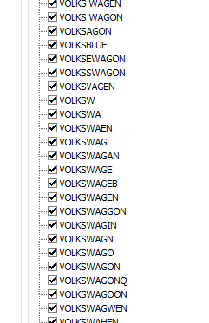
Data Challenges
Typos, typos everywhere
99 categories
But a number ain’t one
So many rows, so little time

Slide 12

The Solution?
Automation didn’t really work… so had to scrub manually
Did breakdown of most commonly misspelled makes
Manually assigned them to the correct value
Dropped the rest of the 10% rows

Slide 13
Some things were done programmatically (sort of)
Using the various Yes/No flags, established accident severity (y-value)
If there was no damage or injury, assign value of 0, otherwise 1
Using specific columns to eliminate duplicate rows
Grouping Makes and Colors into Categories using python dictionaries
Make - Luxury
Color - Bright
Etc..

Slide 14
The Models
Using Decision Trees and Time-Series Analysis

Slide 15
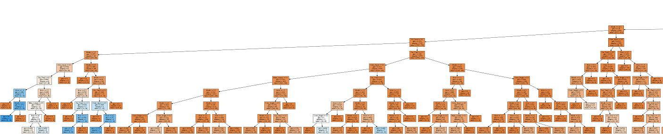
Decision Trees / Forests

Slide 16
Variables
Features used
Color Groupings
Make Grouping
Car Year/Age
Date and Time (Month & Hours)
If driver is local
Age was unavailable
Outcome Variable
If accident was non-trivial (boolean)
Unevenly distributed - 100 to 1 ratio

Slide 17
Fitting the Model
Used DecisionTreeClassifier
Using Gini
Gave weights to the outcome variable due to uneven distribution (class_weight)
Evaluated ROC AUC to determine score
Used GridSearch to find best params
Repeated steps w/ RandomForestClassifier

Slide 18
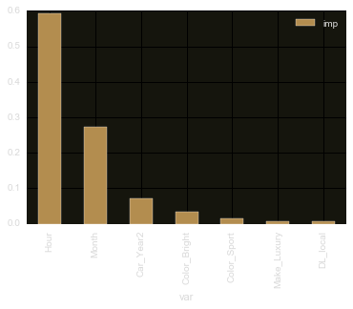
Results
ROC AUC Score
Moving from a tree to a forest improved the score from 0.50 to 0.52
After much tweaking hit bedrock in terms of score
Misclassification Rate = 0.015
Feature Importance Analysis…
Time of day appears to be most significant factor

Slide 19
Re-running the model
Dropping all features except for “Hour” integer and “Make_Luxury” flag
ROC AUC Score
Moved up to 0.61
Slight improvement
0.9 dependency on hour variable
Chances of over-fitting

Slide 20
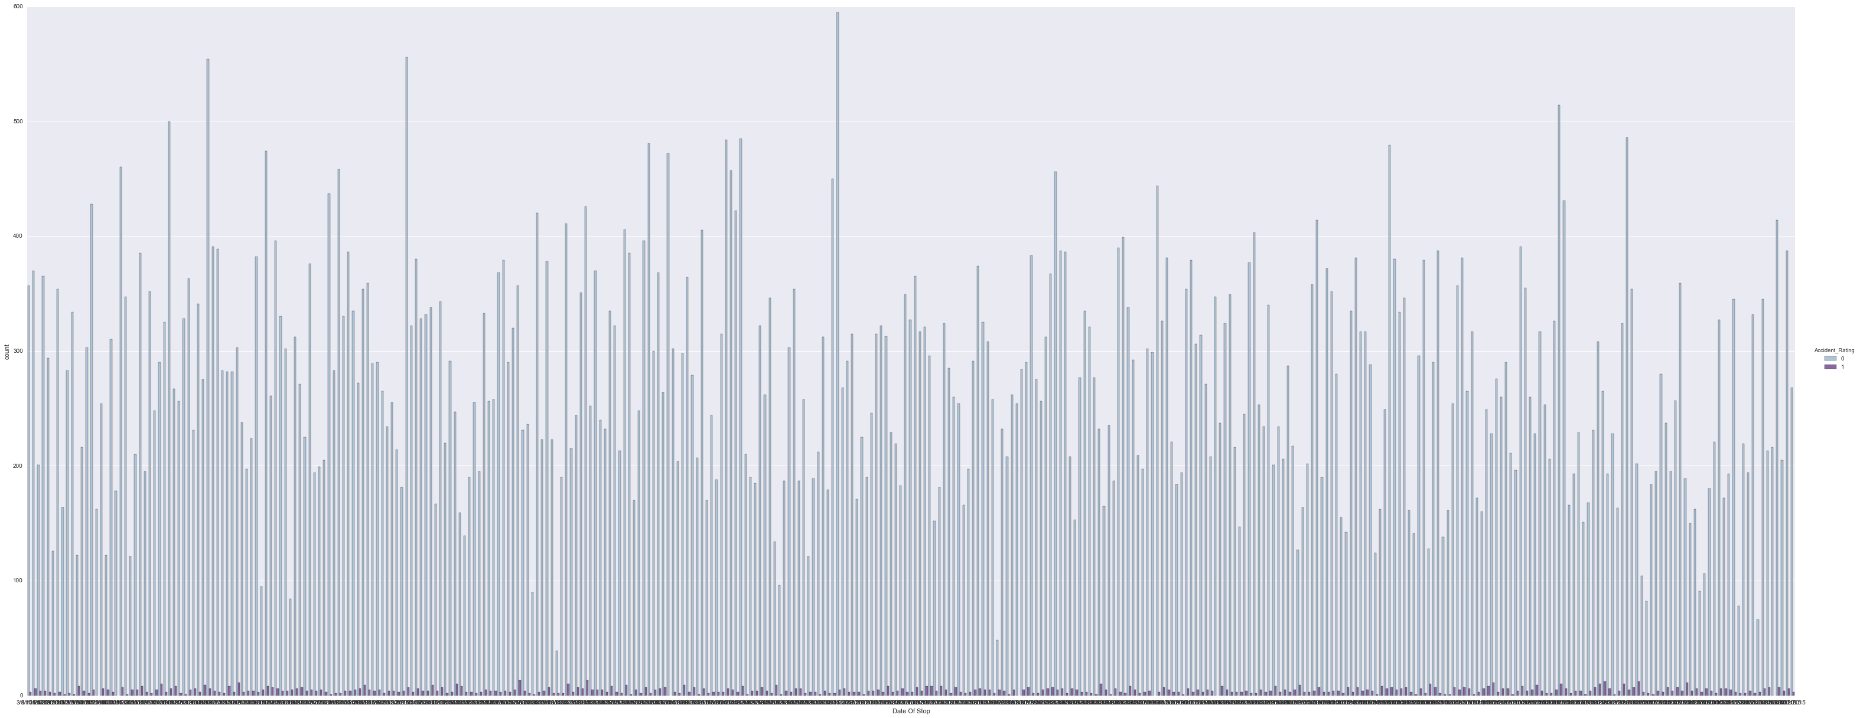
Time Series Analysis

Slide 21
Variables
Features used
Month, Day and Hour
Getting violation counts for each day
Outcome
Predicting a weekly pattern

Slide 22
Fitting the Model
Used ARMA model
Stationary trend
Set frequency to days
Set p’s and q’s to optimize for weekly pattern
Used CSS for performance reasons

Slide 23
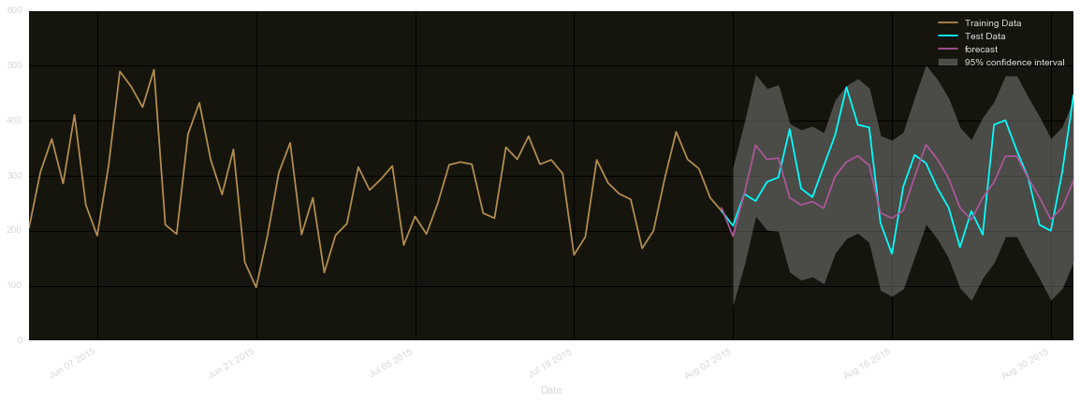
Results
Weekly trend
Peaks on mid-week
Local min on Sunday
Test vs Prediction
Best MES Value = 883.8
Sunday
week

Slide 24
Conclusion
What we’ve seen so far

Slide 25
Analysis
Traffic Violation Data Analysis
No conclusive evidence that Make, Color or Year affect the odds of traffic violation severity
There is some evidence that violations peak midweek and sink on Sundays

Slide 26
In Retrospect…
What we could have done better

Slide 27
Moving Forward
Data Set
Messy and barely usable
Visualized Geo-Location
Invested more time in automated cleanup (NLP?)
Web Scraping to find more variables around car model
Analysis
Limited outcome due to lack of significant variables
Pointed us in the right direction to TSA?
Spend more time investigating feasibility of modeling hourly patterns (lowest freq was “Days”)
Overlay hourly and weekly predictions

Slide 28
The End
It’s okay to speed on Sunday.

